Slide 1
Chapter 11
Sorting, Sets, and Selection
Acknowledgement: These slides are adapted from slides provided with Data Structures and Algorithms in C++, Goodrich, Tamassia and Mount (Wiley 2004) and slides from Nancy M. Amato
Notes:
1
1

Slide 2
Merge Sort
7 2 ⏐ 9 4 → 2 4 7 9
7 ⏐ 2 → 2 7
9 ⏐ 4 → 4 9
7 → 7
2 → 2
9 → 9
4 → 4

Slide 3


Merge-Sort
Merge-sort is based on the divide-and-conquer paradigm. It consists of three steps:
  Divide: partition input sequence $S$ into two sequences $S_{1}$ and $S_{2}$ of about $\frac{n}{2}$ elements each
  Recur: recursively sort $S_{1}$ and $S_{2}$
  Conquer: merge $S_{1}$ and $S_{2}$ into a sorted sequence
Algorithm $mergeSort(S, C)$
Input: Sequence $S$ of $n$ elements,
Comparator $C$
Output: Sequence $S$ sorted according to $C$
if $S.size\left(\right)>1$
$\left(S_{1}, S_{2}\right)←partition\left(S,\frac{n}{2}\right)$
$S_{1}←mergeSort\left(S_{1}, C\right)$
$S_{2}←mergeSort\left(S_{2},C\right)$
$S←merge\left(S_{1},S_{2}\right)$
return $S$

Slide 4

Divide and Conquer Algorithms analysis with recurrence equations
Divide-and conquer is a general algorithm design paradigm:
  Divide: divide the input data $S$ into $k$ (disjoint) subsets $S_{1}, S_{2},…, S_{k}$
  Recur: solve the subproblems recursively
  Conquer: combine the solutions for $S_{1},S_{2},…,S_{k}$ into a solution for $S$
The base case for the recursion are subproblems of constant size
Analysis can be done using recurrence equations (relations)

Slide 5

Divide and Conquer Algorithms analysis with recurrence equations
When the size of all subproblems is the same (frequently the case) the recurrence equation representing the algorithm is:
$T\left(n\right)=D\left(n\right)+kT\left(\frac{n}{c}\right)+C\left(n\right)$
Where
  $D\left(n\right)$ is the cost of dividing $S$ into the $k$ subproblems $S_{1}, S_{2},…,S_{k}$
  There are $k$ subproblems, each of size $\frac{n}{c}$ that will be solved recursively
  $C\left(n\right)$ is the cost of combining the subproblem solutions to get the solution for $S$

Slide 6


Exercise
Recurrence Equation Setup
Algorithm – transform multiplication of two $n$-bit integers $I$ and $J$ into multiplication of $\left(\frac{n}{2}\right)$-bit integers and some additions/shifts
Where does recursion happen in this algorithm?
Rewrite the step(s) of the algorithm to show this clearly.
Algorithm $multiply\left(I,J\right)$
Input: $n$-bit integers $I,J$
Output: $I∗J$
if $n>1$
Split $I$ and $J$ into high and low order halves: $I_{h},I_{l}, J_{h},J_{l}$
$x_{1}←I_{h}∗J_{h}$; $x_{2}←I_{h}∗J_{l}$; $x_{3}←I_{l}∗J_{h}$; $x_{4}←I_{l}∗J_{l}$
$Z←x_{1}∗2^{n}+x_{2}∗2^{\frac{n}{2}}+x_{3}∗2^{\frac{n}{2}}+x_{4}$
else
$Z←I∗J$
return $Z$

Slide 7


Exercise
Recurrence Equation Setup
Algorithm – transform multiplication of two $n$-bit integers $I$ and $J$ into multiplication of $\left(\frac{n}{2}\right)$-bit integers and some additions/shifts
Assuming that additions and shifts of $n$-bit numbers can be done in $O\left(n\right)$ time, describe a recurrence equation showing the running time of this multiplication algorithm
Algorithm $multiply\left(I,J\right)$
Input: $n$-bit integers $I,J$
Output: $I∗J$
if $n>1$
Split $I$ and $J$ into high and low order halves: $I_{h},I_{l}, J_{h},J_{l}$
$x_{1}←multiply\left(I_{h},J_{h}\right)$; $x_{2}←multiply\left(I_{h},J_{l}\right)$;
$x_{3}←multiply\left(I_{l},J_{h}\right)$; $x_{4}←multiply\left(I_{l},J_{l}\right)$
$Z←x_{1}∗2^{n}+x_{2}∗2^{\frac{n}{2}}+x_{3}∗2^{\frac{n}{2}}+x_{4}$
else
$Z←I∗J$
return $Z$

Slide 8

Exercise
Recurrence Equation Setup
Algorithm – transform multiplication of two $n$-bit integers $I$ and $J$ into multiplication of $\left(\frac{n}{2}\right)$-bit integers and some additions/shifts
The recurrence equation for this algorithm is:
  $T\left(n\right)=4T\left(\frac{n}{2}\right)+O\left(n\right)$
  The solution is $O\left(n^{2}\right)$ which is the same as naïve algorithm
Algorithm $multiply\left(I,J\right)$
Input: $n$-bit integers $I,J$
Output: $I∗J$
if $n>1$
Split $I$ and $J$ into high and low order halves: $I_{h},I_{l}, J_{h},J_{l}$
$x_{1}←multiply\left(I_{h},J_{h}\right)$; $x_{2}←multiply\left(I_{h},J_{l}\right)$;
$x_{3}←multiply\left(I_{l},J_{h}\right)$; $x_{4}←multiply\left(I_{l},J_{l}\right)$
$Z←x_{1}∗2^{n}+x_{2}∗2^{\frac{n}{2}}+x_{3}∗2^{\frac{n}{2}}+x_{4}$
else
$Z←I∗J$
return $Z$

Slide 9

Now, back to mergesort…
The running time of Merge Sort can be expressed by the recurrence equation:
$T\left(n\right)=2T\left(\frac{n}{2}\right)+M\left(n\right)$
We need to determine $M\left(n\right)$, the time to merge two sorted sequences each of size $\frac{n}{2}$.
Algorithm $mergeSort(S, C)$
Input: Sequence $S$ of $n$ elements,
Comparator $C$
Output: Sequence $S$ sorted according to $C$
if $S.size\left(\right)>1$
$\left(S_{1}, S_{2}\right)←partition\left(S,\frac{n}{2}\right)$
$S_{1}←mergeSort\left(S_{1}, C\right)$
$S_{2}←mergeSort\left(S_{2},C\right)$
$S←merge\left(S_{1},S_{2}\right)$
return $S$

Slide 10


Merging Two Sorted Sequences
The conquer step of merge-sort consists of merging two sorted sequences $A$ and $B$ into a sorted sequence $S$ containing the union of the elements of $A$ and $B$
Merging two sorted sequences, each with $\frac{n}{2}$ elements and implemented by means of a doubly linked list, takes $O\left(n\right)$ time
  $M\left(n\right)=O\left(n\right)$
Algorithm $merge(A, B)$
Input: Sequences $A,B$ with $\frac{n}{2}$ elements each
Output: Sorted sequence of $A∪B$
$S←∅$
while $¬A.empty\left(\right)∧¬B.empty\left(\right)$
if $A.front\left(\right)<B.front\left(\right)$
$S.insertBack\left(A.front\left(\right)\right)$; $A.eraseFront\left(\right)$
else
$S.insertBack\left(B.front\left(\right)\right)$; $B.eraseFront\left(\right)$
while $¬A.empty\left(\right)$
$S.insertBack\left(A.front\left(\right)\right)$; $A.eraseFront\left(\right)$
while $¬B.empty\left(\right)$
$S.insertBack\left(B.front\left(\right)\right)$; $B.eraseFront\left(\right)$
return $S$

Slide 11

And the complexity of mergesort…
So, the running time of Merge Sort can be expressed by the recurrence equation:
$T\left(n\right)=2T\left(\frac{n}{2}\right)+M\left(n\right)$
$=2T\left(\frac{n}{2}\right)+O\left(n\right)$
$=O\left(n\log{n}\right)$
Algorithm $mergeSort(S, C)$
Input: Sequence $S$ of $n$ elements,
Comparator $C$
Output: Sequence $S$ sorted according to $C$
if $S.size\left(\right)>1$
$\left(S_{1}, S_{2}\right)←partition\left(S,\frac{n}{2}\right)$
$S_{1}←mergeSort\left(S_{1}, C\right)$
$S_{2}←mergeSort\left(S_{2},C\right)$
$S←merge\left(S_{1},S_{2}\right)$
return $S$

Slide 12
Merge-Sort Execution Tree (recursive calls)
An execution of merge-sort is depicted by a binary tree
  Each node represents a recursive call of merge-sort and stores
    Unsorted sequence before the execution and its partition
    Sorted sequence at the end of the execution
  The root is the initial call
  The leaves are calls on subsequences of size 0 or 1
7 2 ⏐ 9 4 → 2 4 7 9
7 ⏐ 2 → 2 7
9 ⏐ 4 → 4 9
7 → 7
2 → 2
9 → 9
4 → 4

Slide 13
Execution Example
Partition
7 2 9 4 ⏐ 3 8 6 1 → 1 2 3 4 6 7 8 9
7 2 9 4 → 2 4 7 9
3 8 6 1 → 1 3 8 6
7 2 → 2 7
9 4 → 4 9
3 8 → 3 8
6 1 → 1 6
7 → 7
2 → 2
9 → 9
4 → 4
3 → 3
8 → 8
6 → 6
1 → 1

Slide 14
Execution Example
Recursive Call, partition
7 2 9 4 ⏐ 3 8 6 1 → 1 2 3 4 6 7 8 9
7 2 | 9 4 → 2 4 7 9
3 8 6 1 → 1 3 8 6
7 2 → 2 7
9 4 → 4 9
3 8 → 3 8
6 1 → 1 6
7 → 7
2 → 2
9 → 9
4 → 4
3 → 3
8 → 8
6 → 6
1 → 1

Slide 15
Execution Example
Recursive Call, partition
7 2 9 4 ⏐ 3 8 6 1 → 1 2 3 4 6 7 8 9
7 2 | 9 4 → 2 4 7 9
3 8 6 1 → 1 3 8 6
7 | 2 → 2 7
9 4 → 4 9
3 8 → 3 8
6 1 → 1 6
7 → 7
2 → 2
9 → 9
4 → 4
3 → 3
8 → 8
6 → 6
1 → 1

Slide 16
Execution Example
Recursive Call, base case
7 2 9 4 ⏐ 3 8 6 1 → 1 2 3 4 6 7 8 9
7 2 | 9 4 → 2 4 7 9
3 8 6 1 → 1 3 8 6
7 | 2 → 2 7
9 4 → 4 9
3 8 → 3 8
6 1 → 1 6
7 → 7
2 → 2
9 → 9
4 → 4
3 → 3
8 → 8
6 → 6
1 → 1

Slide 17
Execution Example
Recursive Call, base case
7 2 9 4 ⏐ 3 8 6 1 → 1 2 3 4 6 7 8 9
7 2 | 9 4 → 2 4 7 9
3 8 6 1 → 1 3 8 6
7 | 2 → 2 7
9 4 → 4 9
3 8 → 3 8
6 1 → 1 6
7 → 7
2 → 2
9 → 9
4 → 4
3 → 3
8 → 8
6 → 6
1 → 1

Slide 18
Execution Example
Merge
7 2 9 4 ⏐ 3 8 6 1 → 1 2 3 4 6 7 8 9
7 2 | 9 4 → 2 4 7 9
3 8 6 1 → 1 3 8 6
7 | 2 → 2 7
9 4 → 4 9
3 8 → 3 8
6 1 → 1 6
7 → 7
2 → 2
9 → 9
4 → 4
3 → 3
8 → 8
6 → 6
1 → 1

Slide 19
Execution Example
Recursive call, …, base case, merge
7 2 9 4 ⏐ 3 8 6 1 → 1 2 3 4 6 7 8 9
7 2 | 9 4 → 2 4 7 9
3 8 6 1 → 1 3 8 6
7 | 2 → 2 7
9 | 4 → 4 9
3 8 → 3 8
6 1 → 1 6
7 → 7
2 → 2
9 → 9
4 → 4
3 → 3
8 → 8
6 → 6
1 → 1

Slide 20
Execution Example
Merge
7 2 9 4 ⏐ 3 8 6 1 → 1 2 3 4 6 7 8 9
7 2 | 9 4 → 2 4 7 9
3 8 6 1 → 1 3 8 6
7 | 2 → 2 7
9 | 4 → 4 9
3 8 → 3 8
6 1 → 1 6
7 → 7
2 → 2
9 → 9
4 → 4
3 → 3
8 → 8
6 → 6
1 → 1

Slide 21
Execution Example
Recursive call, …, merge, merge
7 2 9 4 ⏐ 3 8 6 1 → 1 2 3 4 6 7 8 9
7 2 | 9 4 → 2 4 7 9
3 8 | 6 1 → 1 3 8 6
7 | 2 → 2 7
9 | 4 → 4 9
3 | 8 → 3 8
6 | 1 → 1 6
7 → 7
2 → 2
9 → 9
4 → 4
3 → 3
8 → 8
6 → 6
1 → 1

Slide 22
Execution Example
Merge
7 2 9 4 ⏐ 3 8 6 1 → 1 2 3 4 6 7 8 9
7 2 | 9 4 → 2 4 7 9
3 8 | 6 1 → 1 3 8 6
7 | 2 → 2 7
9 | 4 → 4 9
3 | 8 → 3 8
6 | 1 → 1 6
7 → 7
2 → 2
9 → 9
4 → 4
3 → 3
8 → 8
6 → 6
1 → 1

Slide 23
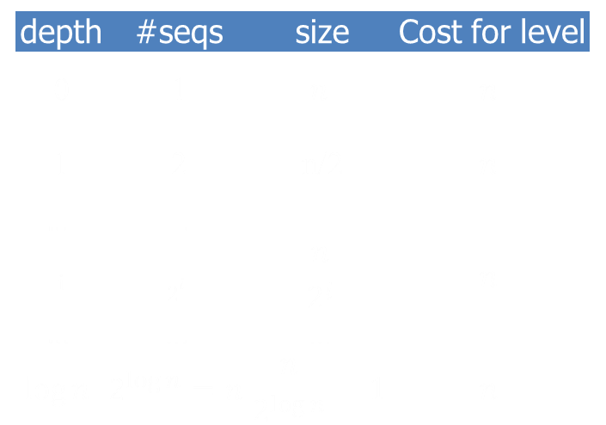

Another Analysis of Merge-Sort
depth | #seqs | size | Cost for level
0 | 1 | $$n$$ | $$n$$
1 | 2 | n/2 | $$n$$
$$…$$ | $$…$$ | $$…$$
_{i} | $$2^{i}$$ | $$\frac{n}{2^{i}}$$ | $$n$$
$$…$$ | $$…$$ | $$…$$
$$\log{n}$$ | $$2^{\log{n}}=n$$ | $$\frac{n}{2^{\log{n}}}=1$$ | $$n$$
The height $h$ of the merge-sort tree is $O\left(\log{n}\right)$
  at each recursive call we divide in half the sequence,
The work done at each level is $O\left(n\right)$
  At level $i$, we partition and merge $2^{i}$ sequences of size $\frac{n}{2^{i}}$
Thus, the total running time of merge-sort is $O\left(n\log{n}\right)$

Slide 24
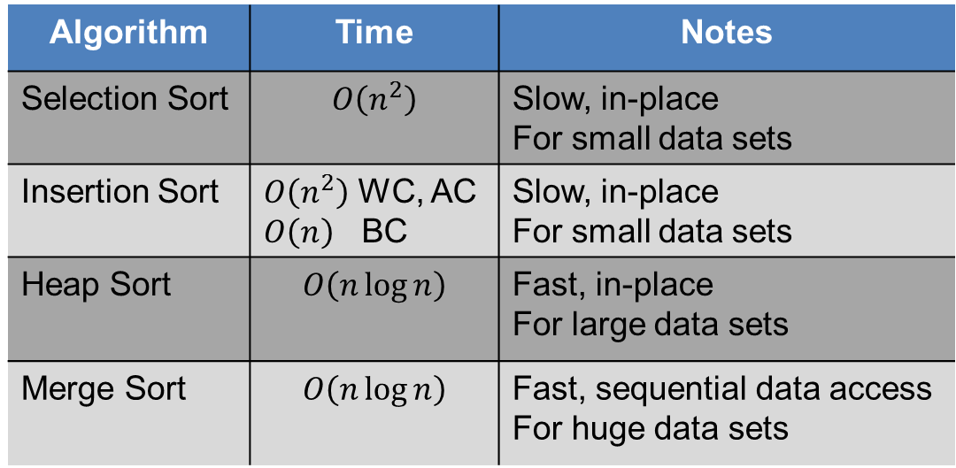
Summary of Sorting Algorithms (so far)
Algorithm | Time | Notes
Selection Sort | $$O\left(n^{2}\right)$$ | Slow, in-place For small data sets
Insertion Sort | $O\left(n^{2}\right)$ WC, AC $O\left(n\right)$ BC | Slow, in-place For small data sets
Heap Sort | $$O\left(n\log{n}\right)$$ | Fast, in-place For large data sets
Merge Sort | $$O\left(n\log{n}\right)$$ | Fast, sequential data access For huge data sets

Slide 25
Quick-Sort
7 4 9 6 2 → 2 4 6 7 9
4 2 → 2 4
7 9 → 7 9
2 → 2
9 → 9

Slide 26

Quick-Sort
Quick-sort is a randomized sorting algorithm based on the divide-and-conquer paradigm:
  Divide: pick a random element
  $x$ (called pivot) and partition $S$ into
    $L$ - elements less than $x$
    $E$ - elements equal $x$
    $G$ - elements greater than $x$
  Recur: sort $L$ and $G$
  Conquer: join $L$, $E$, and $G$
x
x
L
G
E
x

Slide 27


Analysis of Quick Sort using Recurrence Relations
Assumption: random pivot expected to give equal sized sublists
The running time of Quick Sort can be expressed as:
$T\left(n\right)=2T\left(\frac{n}{2}\right)+P\left(n\right)$
$P\left(n\right)$ - time to run $partition\left(\right)$ on input of size $n$
Algorithm $quickSort(S, l, r)$
Input: Sequence $S$, indices $l, r$
Output: Sequence $S$ with the elements
between $l$ and $r$ sorted
if $l≥r$
return $S$
$i←rand\left(\right)\%\left(r−l\right)+l$
//random integer between $l$ and $r$
$x←S.at\left(i\right)$
$\left(h, k\right)←partition\left(x\right)$
$quickSort\left(S, l, h−1\right)$
$quickSort\left(S, k+1 , r\right)$
return $S$

Slide 28


Partition
We partition an input sequence as follows:
  We remove, in turn, each element $y$ from $S$ and
  We insert $y$ into $L$, $E$, or $G$, depending on the result of the comparison with the pivot $x$
Each insertion and removal is at the beginning or at the end of a sequence, and hence takes $O\left(1\right)$ time
Thus, the partition step of quick-sort takes $O\left(n\right)$ time
Algorithm $partition\left(S, p\right)$
Input: Sequence $S$, position $p$ of the pivot
Output: Subsequences $L, E, G$ of the elements of $S$
less than, equal to, or greater than the pivot,
respectively
$L, E, G←∅$
$x←S.erase\left(p\right)$
while $¬S.empty\left(\right)$
$y←S.eraseFront\left(\right)$
if $y<x$
$L.insertBack\left(y\right)$
else if $y=x$
$E.insertBack\left(y\right)$
else //$y>x$
$G.insertBack\left(y\right)$
return $L,E,G$

Slide 29

So, the expected complexity of Quick Sort
Assumption: random pivot expected to give equal sized sublists
The running time of Quick Sort can be expressed as:
$T\left(n\right)=2T\left(\frac{n}{2}\right)+P\left(n\right)$
$=2T\left(\frac{n}{2}\right)+O\left(n\right)$
$=O\left(n\log{n}\right)$
Algorithm $quickSort(S, l, r)$
Input: Sequence $S$, indices $l, r$
Output: Sequence $S$ with the elements
between $l$ and $r$ sorted
if $l≥r$
return $S$
$i←rand\left(\right)\%\left(r−l\right)+l$
//random integer between $l$ and $r$
$x←S.at\left(i\right)$
$\left(h, k\right)←partition\left(x\right)$
$quickSort\left(S, l, h−1\right)$
$quickSort\left(S, k+1 , r\right)$
return $S$

Slide 30
Quick-Sort Tree
An execution of quick-sort is depicted by a binary tree
  Each node represents a recursive call of quick-sort and stores
    Unsorted sequence before the execution and its pivot
    Sorted sequence at the end of the execution
  The root is the initial call
  The leaves are calls on subsequences of size 0 or 1
7 4 9 6 2 → 2 4 6 7 9
4 2 → 2 4
7 9 → 7 9
2 → 2
9 → 9

Slide 31
Execution Example
Pivot selection
7 2 9 4 3 7 6 1 → 1 2 3 4 6 7 7 9
2 4 3 1 → 1 2 3 4
7 9 7 → 7 7 9
1 → 1
4 3 → 3 4
9 → 9
4 → 4

Slide 32
Execution Example
Partition, recursive call, pivot selection
7 2 9 4 3 7 6 1 → 1 2 3 4 6 7 7 9
2 4 3 1 → 1 2 3 4
7 9 7 → 7 7 9
1 → 1
4 3 → 3 4
9 → 9
4 → 4

Slide 33
Execution Example
Partition, recursive call, base case
7 2 9 4 3 7 6 1 → 1 2 3 4 6 7 7 9
2 4 3 1 → 1 2 3 4
7 9 7 → 7 7 9
1 → 1
4 3 → 3 4
9 → 9
4 → 4

Slide 34
Execution Example
Recursive call, …, base case, join
7 2 9 4 3 7 6 1 → 1 2 3 4 6 7 7 9
2 4 3 1 → 1 2 3 4
7 9 7 → 7 7 9
1 → 1
4 3 → 3 4
9 → 9
4 → 4

Slide 35
Execution Example
Recursive call, pivot selection
7 2 9 4 3 7 6 1 → 1 2 3 4 6 7 7 9
2 4 3 1 → 1 2 3 4
7 9 7 → 7 7 9
1 → 1
4 3 → 3 4
9 → 9
4 → 4

Slide 36
Execution Example
Partition, …, recursive call, base case
7 2 9 4 3 7 6 1 → 1 2 3 4 6 7 7 9
2 4 3 1 → 1 2 3 4
7 9 7 → 7 7 9
1 → 1
4 3 → 3 4
9 → 9
4 → 4

Slide 37
Execution Example
Join, join
7 2 9 4 3 7 6 1 → 1 2 3 4 6 7 7 9
2 4 3 1 → 1 2 3 4
7 9 7 → 7 7 9
1 → 1
4 3 → 3 4
9 → 9
4 → 4

Slide 38

Worst-case Running Time
depth | time
0 | n
1 | n − 1
… | …
n − 1 | 1
The worst case for quick-sort occurs when the pivot is the unique minimum or maximum element
  One of $L$ and $G$ has size $n−1$and the other has size $0$
The running time is proportional to:
$n+\left(n−1\right)+…+2+1=O\left(n^{2}\right)$
Alternatively, using recurrence equations:
$T\left(n\right)=T\left(n−1\right)+O\left(n\right)=O\left(n^{2}\right)$
…

Slide 39

Expected Running Time removing equal split assumption
Consider a recursive call of quick-sort on a sequence of size $s$
  Good call: the sizes of $L$ and $G$ are each less than $\frac{3s}{4}$
  Bad call: one of $L$ and $G$ has size greater than $\frac{3s}{4}$
A call is good with probability 1/2
  1/2 of the possible pivots cause good calls:
7 2 9 4 3 7 6 1 9
7 2 9 4 3 7 6 1
2 4 3 1
7 9 7 6
1
7 2 9 4 3 7 6
Good call
Bad call
1 2 3 4 5 6 7 8 9 10 11 12 13 14 15 16
Bad pivots
Good pivots
Bad pivots

Slide 40

Expected Running Time
Probabilistic Fact: The expected number of coin tosses required in order to get $k$ heads is $2k$ (e.g., it is expected to take 2 tosses to get heads)
For a node of depth $i$, we expect
  $\frac{i}{2}$ ancestors are good calls
  The size of the input sequence for the current call is at most ${\left(\frac{3}{4}\right)}^{\frac{i}{2}}n$
Therefore, we have
  For a node of depth $2\log_{\frac{4}{3}}{n}$, the expected input size is one
  The expected height of the quick-sort tree is $O\left(\log{n}\right)$
The amount or work done at the nodes of the same depth is $O\left(n\right)$
Thus, the expected running time of quick-sort is $O\left(n\log{n}\right)$

Slide 41


In-Place Quick-Sort
Quick-sort can be implemented to run in-place
In the partition step, we use replace operations to rearrange the elements of the input sequence such that
  the elements less than the pivot have indices less than $h$
  the elements equal to the pivot have indices between $h$ and $k$
  the elements greater than the pivot have indices greater than $k$
The recursive calls consider
  elements with indices less than $h$
  elements with indices greater than $k$
Algorithm $inPlaceQuickSort(S, l, r)$
Input: Array $S$, indices $l, r$
Output: Array $S$ with the elements between $l$ and $r$ sorted
if $l≥r$
return $S$
$i←rand\left(\right)\%\left(r−l\right)+l$
//random integer between $l$ and $r$
$x←S\left[i\right]$
$\left(h, k\right)←inPlacePartition\left(x\right)$
$inPlaceQuickSort(S, l, h−1)$
$inPlaceQuickSort\left(S, k+1, r\right)$
return $S$

Slide 42



In-Place Partitioning
Perform the partition using two indices to split $S$ into $L$ and $E∪G$ (a similar method can split $E∪G$ into $E$ and $G$).
Repeat until $j$ and $k$ cross:
  Scan $j$ to the right until finding an element $≥x$.
  Scan $k$ to the left until finding an element $<x$.
  Swap elements at indices $j$ and $k$
j
k
3 2 5 1 0 7 3 5 9 2 7 9 8 9 7 6 9
(pivot = 6)
$$j$$
$$k$$
3 2 5 1 0 7 3 5 9 2 7 9 8 9 7 6 9

Slide 43
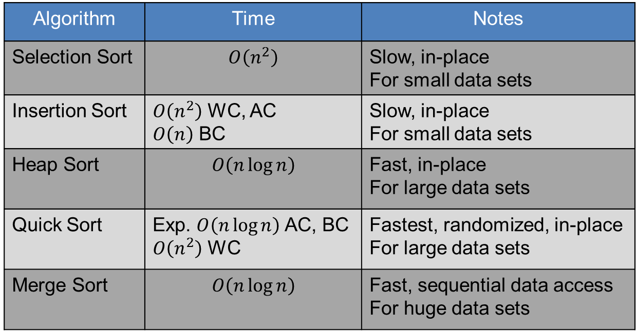
Summary of Sorting Algorithms (so far)
Algorithm | Time | Notes
Selection Sort | $$O\left(n^{2}\right)$$ | Slow, in-place For small data sets
Insertion Sort | $O\left(n^{2}\right)$ WC, AC $O\left(n\right)$ BC | Slow, in-place For small data sets
Heap Sort | $$O\left(n\log{n}\right)$$ | Fast, in-place For large data sets
Quick Sort | Exp. $O\left(n\log{n}\right)$ AC, BC $O\left(n^{2}\right)$ WC | Fastest, randomized, in-place For large data sets
Merge Sort | $$O\left(n\log{n}\right)$$ | Fast, sequential data access For huge data sets

Slide 44
Sorting Lower Bound

Slide 45


Comparison-Based Sorting
Many sorting algorithms are comparison based.
  They sort by making comparisons between pairs of objects
  Examples: bubble-sort, selection-sort, insertion-sort, heap-sort, merge-sort, quick-sort, ...
Let us therefore derive a lower bound on the running time of any algorithm that uses comparisons to sort $n$ elements, $x_{1},x_{2},…,x_{n}$.
Is $x_{i}<x_{j}$?
no
yes

Slide 46
Counting Comparisons
Let us just count comparisons then.
Each possible run of the algorithm corresponds to a root-to-leaf path in a decision tree

Slide 47

Decision Tree Height
The height of the decision tree is a lower bound on the running time
Every input permutation must lead to a separate leaf output
If not, some input …4…5… would have same output ordering as …5…4…, which would be wrong
Since there are $n!=1∗2∗…∗n$ leaves, the height is at least $\log\left(n!\right)$

Slide 48

The Lower Bound
Any comparison-based sorting algorithm takes at least $\log\left(n!\right)$ time
$\log{(n!)}≥\log{{\left(\frac{n}{2}\right)}^{\frac{n}{2}}=\frac{n}{2}\log{\frac{n}{2}}}$
That is, any comparison-based sorting algorithm must run in $Ω(n\log{n}$) time.

Slide 49
Bucket-Sort and Radix-Sort
Can we sort in linear time?
1, c
3, a
3, b
7, d
7, g
7, e
∅
∅
∅
∅
∅
∅
∅
B
0
1
2
3
4
5
6
7
8
9

Slide 50


Bucket-Sort
Let be S be a sequence of $n$ (key, element) items with keys in the range $\left[0,N−1\right]$
Bucket-sort uses the keys as indices into an auxiliary array $B$ of sequences (buckets)
  Phase 1: Empty sequence $S$ by moving each entry into its bucket $B\left[k\right]$
  Phase 2: for $i←0…N−1$, move the items of bucket $B\left[i\right]$ to the end of sequence $S$
Analysis:
  Phase 1 takes $O\left(n\right)$ time
  Phase 2 takes $O\left(n+N\right)$ time
Bucket-sort takes $O\left(n+N\right)$ time
Algorithm $bucketSort(S, N)$
Input: Sequence $S$ of entries with integer keys in the range $\left[0, N−1\right]$
Output: Sequence $S$ sorted in nondecreasing order of the keys
$B←$ array of $N$ empty sequences
for each entry $e∈S$ do
$k←e.key\left(\right)$
remove $e$ from $S$ and insert it at the end of bucket $B\left[k\right]$
for $i←0…N−1$ do
for each entry $e∈B\left[i\right]$ do
remove $e$ from bucket $B\left[i\right]$ and insert it at the end of $S$

Slide 51

Properties and Extensions
Properties
  Key-type
    The keys are used as indices into an array and cannot be arbitrary objects
    No external comparator
  Stable sorting
    The relative order of any two items with the same key is preserved after the execution of the algorithm
Extensions
  Integer keys in the range $\left[a,b\right]$
    Put entry $e$ into bucket
    $B\left[k−a\right]$
  String keys from a set $D$ of possible strings, where $D$ has constant size (e.g., names of the 50 U.S. states)
    Sort $D$ and compute the index $i\left(k\right)$ of each string $k$ of $D$ in the sorted sequence
    Put item $e$ into bucket $B\left[i\left(k\right)\right]$

Slide 52
Example
Key range [37, 46] – map to buckets [0,9]
45, d
37, c
40, a
45, g
40, b
46, e
Phase 1
37, c
40, a
40, b
45, d
45, g
B
0
1
2
3
4
5
6
7
8
9
46, e
∅
∅
∅
∅
∅
∅
Phase 2
37, c
40, a
40, b
45, d
45, g
46, e
Notes:
Is it in-place?
Is it stable?
Can we use a hash table instead of a bucket array?

Slide 53
Lexicographic Order
Given a list of tuples:
(7,4,6) (5,1,5) (2,4,6) (2,1,4) (5,1,6) (3,2,4)
After sorting, the list is in lexicographical order:
(2,1,4) (2,4,6) (3,2,4) (5,1,5) (5,1,6) (7,4,6)
Notes:
Non-decreasing order

Slide 54

Lexicographic Order Formalized
A $d$-tuple is a sequence of $d$ keys $\left(k_{1}, k_{2},…,k_{d}\right)$, where key $k_{i}$ is said to be the $i$-th dimension of the tuple
  Example - the Cartesian coordinates of a point in space is a 3-tuple $\left(x, y, z\right)$
The lexicographic order of two $d$-tuples is recursively defined as follows
$\left(x_{1},x_{2},…,x_{d}\right)<\left(y_{1},y_{2},…,y_{d}\right)\underset{⇔}{}$
$x_{1}<y_{1}∨\left(x_{1}=y_{1}∧\left(x_{2},…,x_{d}\right)<\left(y_{2},…,y_{d}\right)\right)$
i.e., the tuples are compared by the first dimension, then by the second dimension, etc.

Slide 55
Exercise
Lexicographic Order
Given a list of 2-tuples, we can order the tuples lexicographically by applying a stable sorting algorithm two times:
(3,3) (1,5) (2,5) (1,2) (2,3) (1,7) (3,2) (2,2)
Possible ways of doing it:
  Sort first by 1st element of tuple and then by 2nd element of tuple
  Sort first by 2nd element of tuple and then by 1st element of tuple
Show the result of sorting the list using both options
Notes:
Non-decreasing order
What must it be stable?

Slide 56
Exercise
Lexicographic Order
(3,3) (1,5) (2,5) (1,2) (2,3) (1,7) (3,2) (2,2)
Using a stable sort,
  Sort first by 1st element of tuple and then by 2nd element of tuple
  Sort first by 2nd element of tuple and then by 1st element of tuple
Option 1:
  1st sort: (1,5) (1,2) (1,7) (2,5) (2,3) (2,2) (3,3) (3,2)
  2nd sort: (1,2) (2,2) (3,2) (2,3) (3,3) (1,5) (2,5) (1,7) - WRONG
Option 2:
  1st sort: (1,2) (3,2) (2,2) (3,3) (2,3) (1,5) (2,5) (1,7)
  2nd sort: (1,2) (1,5) (1,7) (2,2) (2,3) (2,5) (3,2) (3,3) - CORRECT
Notes:
Non-decreasing order
What must it be stable?

Slide 57


Lexicographic-Sort
Let $C_{i}$ be the comparator that compares two tuples by their $i$-th dimension
Let $stableSort(S, C)$be a stable sorting algorithm that uses comparator $C$
Lexicographic-sort sorts a sequence of $d$-tuples in lexicographic order by executing $d$ times algorithm $stableSort$, one per dimension
Lexicographic-sort runs in $O\left(dT\left(n\right)\right)$ time, where $T\left(n\right)$ is the running time of $stableSort$
Algorithm $lexicographicSort(S)$
Input: Sequence $S$ of $d$-tuples
Output: Sequence $S$ sorted in lexicographic order
for $i←d…1$ do
$stableSort\left(S,C_{i}\right)$

Slide 58


Radix-Sort
Radix-sort is a specialization of lexicographic-sort that uses bucket-sort as the stable sorting algorithm in each dimension
Radix-sort is applicable to tuples where the keys in each dimension $i$ are integers in the range $\left[0,N−1\right]$
Radix-sort runs in time $O\left(d\left(n+N\right)\right)$
Algorithm $radixSort\left(S,N\right)$
Input: Sequence $S$ of $d$-tuples such that
$\left(0,…,0\right)≤\left(x_{1},…,x_{d}\right)$ and
$\left(x_{1},…,x_{d}\right)≤\left(N−1,…,N−1\right)$
for each tuple $\left(x_{1},…,x_{d}\right)$ in $S$
Output: Sequence $S$ sorted in lexicographic order
for $i←d…1$ do
set the key $k$ of each entry $\left(k,\left(x_{1},…,x_{d}\right)\right)$
of $S$ to $i$th dimension $x_{i}$
$bucketSort\left(S,N\right)$

Slide 59

Example
Radix-Sort for Binary Numbers
Sorting a sequence of 4-bit integers
  $d=4,N=2$ so $O\left(d\left(n+N\right)\right)=O\left(4\left(n+2\right)\right)=O\left(n\right)$
1001
0010
1001
1001
0001
0010
1110
1101
0001
0010
1101
1001
0001
0010
1001
0001
1101
0010
1101
1101
1110
0001
1110
1110
1110
Sort by d=4
Sort by d=3
Sort by d=2
Sort by d=1
Notes:
What’s the complexity? What’s the constant in O(d( n + N))

Slide 60
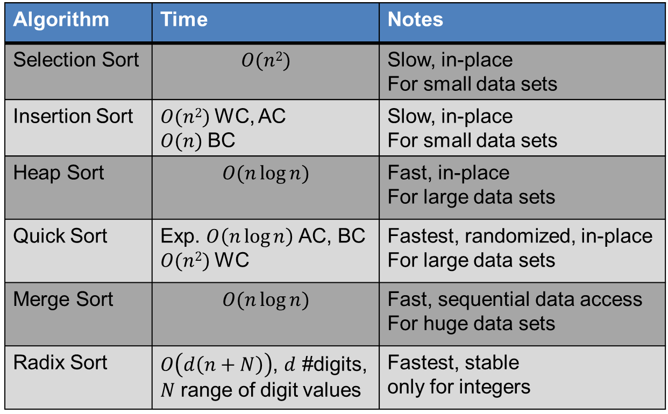
Summary of Sorting Algorithms
Algorithm | Time | Notes
Selection Sort | $$O(n2)$$ | Slow, in-place For small data sets
Insertion Sort | $O(n2)$WC, AC $O(n)$BC | Slow, in-place For small data sets
Heap Sort | $$O(n\log{n})$$ | Fast, in-place For large data sets
Quick Sort | Exp. $O\left(n\log{n}\right)$ AC, BC $O(n2)$WC | Fastest, randomized, in-place For large data sets
Merge Sort | $$O(n\log{n})$$ | Fast, sequential data access For huge data sets
Radix Sort | $O\left(d\left(n+N\right)\right)$, $d$ #digits, $N$ range of digit values | Fastest, stable only for integers

Slide 61
Sets

Slide 62


Set Operations
A set is an ordered data structure similar to an ordered map, except only elements are stored (and yes elements must be unique)
We represent a set by the sorted sequence of its elements
By specializing the auxiliary methods the generic merge algorithm can be used to perform basic set operations:
  Union - $A∪B$ – Return all elements which appear in $A$ or $B$ (unique only)
  Intersection - $A∩B$ – Return only elements which appear in both $A$ and $B$
  Subtraction - $A∖B$ – Return elements in $A$ which are not in $B$
The running time of an operation on sets $A$ and $B$ should be at most $O\left(n_{A}+n_{B}\right)$
Set union:
  if $a<b$
  $S.insertFront(a)$
  if $b<a$
  $S.insertFront(b)$
  else $a=b$
  $S.insertFront(a)$
Set intersection:
  if $a<b$
  $\{do nothing\}$
  if $b<a$
  $\{do nothing\}$
  else $a=b$
  $S.insertBack(a)$

Slide 63


Generic Merging
Algorithm $genericMerge(A, B)$
Input: Sets $A,B$ (implemented as sequences)
Output: Set $S$
$S←∅$
while $¬A.empty\left(\right)∧¬B.empty\left(\right)$ do
$a←A.front\left(\right)$; $b←B.front\left(\right)$
if $a<b$
$aIsLess(a, S)$ //generic action
$A.eraseFront\left(\right);$
else if $b<a$
$bIsLess(b, S)$ //generic action
$B.eraseFront\left(\right)$
else //$a=b$
$bothAreEqual(a, b, S)$ //generic action
$A.eraseFront\left(\right)$; $B.eraseFront\left(\right)$
while $¬A.empty()$ do
$aIsLess(A.front\left(\right), S)$; $A.eraseFront\left(\right)$
while $¬B.empty()$ do
$bIsLess(B.front\left(\right), S)$; $B.eraseFront\left(\right)$
return $S$
Generalized merge of two sorted sets $A$ and $B$
Auxiliary methods (generic functions)
  $aIsLess\left(a, S\right)$
  $bIsLess(b, S)$
  $bothAreEqual\left(a, b, S\right)$
Runs in $O\left(n_{A}+n_{B}\right)$ time provided the auxiliary methods run in $O\left(1\right)$ time

Slide 64
Using Generic Merge for Set Operations
Any of the set operations can be implemented using a generic merge
For example:
  For intersection: only copy elements that are duplicated in both list
  For union: copy every element from both lists except for the duplicates
All methods run in linear time

Slide 65
Better/Typical Set Implementation
Can use search trees such that the key is equivalent to the element to implement a set, allows fast ordering of data
<
6
2
>
9
1
4
=
8

Slide 66
Selection

Slide 67

The Selection Problem
Given an integer $k$ and $n$ elements $\left\{x_{1}, x_{2}, …, x_{n}\right\}$, taken from a total order, find the $k$-th smallest element in this set.
  Also called order statistics, the $i$th order statistic is the $i$th smallest element
  Minimum - $k=1$ - 1st order statistic
  Maximum - $k=n$ - $n$th order statistic
  Median - $k=\left\lfloor \frac{n}{2}\right\rfloor$
  etc

Slide 68

The Selection Problem
Naïve solution - SORT!
We can sort the set in $O\left(n\log{n}\right)$ time and then index the $k$-th element.
Can we solve the selection problem faster?
7 4 9 6 2 → 2 4 6 7 9
k=3

Slide 69

The Minimum (or Maximum)
Algorithm $minimum(A)$
Input: Array $A$
Output: minimum element in $A$
$m←A\left[1\right]$
for $i←2…n$ do
$m←\min\left(m,A\left[i\right]\right)$
return $m$
Running Time
  $O(n)$
Is this the best possible?

Slide 70




Quick-Select
x
Quick-select is a randomized selection algorithm based on the prune-and-search paradigm:
  Prune: pick a random element $x$ (called pivot) and partition $S$ into
    $L$ elements $<x$
    $E$ elements $=x$
    $G$ elements $>x$
  Search: depending on $k$, either answer is in $E$, or we need to recur on either $L$ or $G$
Note: Partition same as Quicksort
x
L
G
E
$$k≤|L|$$
$$k>\left|L\right|+\left|E\right|$$
$$k’=k−\left|L\right|−\left|E\right|$$
$$\left|L\right|<k≤\left|L\right|+\left|E\right|$$
$$(done)$$

Slide 71






Quick-Select Visualization
An execution of quick-select can be visualized by a recursion path
  Each node represents a recursive call of quick-select, and stores $k$ and the remaining sequence
$$k=5, S=(7, 4,9, \underline{3}, 2, 6, 5, 1, 8)$$
$$k=2, S=(7, 4, 9, 6, 5, \underline{8})$$
$$k=2, S=(7,\underline{4}, 6, 5)$$
$$k=1, S=(7, 6, \underline{5})$$
$$5$$

Slide 72
Exercise
Best Case - even splits (n/2 and n/2)
Worst Case - bad splits (1 and n-1)
Derive and solve the recurrence relation corresponding to the best case performance of randomized quick-select.
Derive and solve the recurrence relation corresponding to the worst case performance of randomized quick-select.
7 2 9 4 3 7 6 1 9
7 2 9 4 3 7 6 1
2 4 3 1
7 2 9 4 3 7 6
Good call
Bad call

Slide 73

Expected Running Time
Consider a recursive call of quick-select on a sequence of size $s$
  Good call: the size of $L$ and $G$ is at most $\frac{3s}{4}$
  Bad call: the size of $L$ and $G$ is greater than $\frac{3s}{4}$
A call is good with probability 1/2
  1/2 of the possible pivots cause good calls:
7 2 9 4 3 7 6 1 9
7 2 9 4 3 7 6 1
2 4 3 1
7 9 7 1 → 1
1
7 2 9 4 3 7 6
Good call
Bad call
1 2 3 4 5 6 7 8 9 10 11 12 13 14 15 16
Bad pivots
Good pivots
Bad pivots

Slide 74

Expected Running TimE
Probabilistic Fact #1: The expected number of coin tosses required in order to get one head is two
Probabilistic Fact #2: Expectation is a linear function:
  $E\left(X+Y\right)=E\left(X\right)+E(Y)$
  $E\left(cX\right)=cE(X)$
Let $T\left(n\right)$ denote the expected running time of quick-select.
By Fact #2, $T\left(n\right)<T\left(\frac{3n}{4}\right)+bn∗\left(expected \# of calls before a good call\right)$
By Fact #1, $T\left(n\right)<T\left(\frac{3n}{4}\right)+2bn$
That is, $T\left(n\right)$ is a geometric series: $T\left(n\right)<2bn+2b\left(\frac{3}{4}\right)n+2b{\left(\frac{3}{4}\right)}^{2}n+2b{\left(\frac{3}{4}\right)}^{3}n+…$
So $T\left(n\right)$ is $O\left(n\right)$.
We can solve the selection problem in $O\left(n\right)$ expected time.

Slide 75



Deterministic Selection
We can do selection in $O\left(n\right)$ worst-case time.
Main idea: recursively use the selection algorithm itself to find a good pivot for quick-select:
  Divide $S$ into $\frac{n}{5}$ sets of 5 each
  Find a median in each set
  Recursively find the median of the “baby” medians.
See Exercise C-11.22 for details of analysis.
Min size
for $L$
1
1
1
1
1
1
1
1
1
1
1
2
2
2
2
2
2
2
2
2
2
2
3
3
3
3
3
3
3
3
3
3
3
Min size
for $G$
4
4
4
4
4
4
4
4
4
4
4
5
5
5
5
5
5
5
5
5
5
5

Slide 76

Interview Question 1
You are given two sorted arrays, $A$ and $B$, where $A$ has a large enough buffer at the end to hold $B$. Write a method to merge $B$ into $A$ in sorted order.

Slide 77
Interview Question 2
Write a method to sort an array of strings so that all the anagrams are next to each other.
  Two words are anagrams if they use the exact same letters, i.e., race and care are anagrams

Slide 78
Interview Question 3
Imagine you have a 2 TB file with one string per line. Explain how you would sort the file.

